Slide 1
Scaling in the Cloud

Slide 2
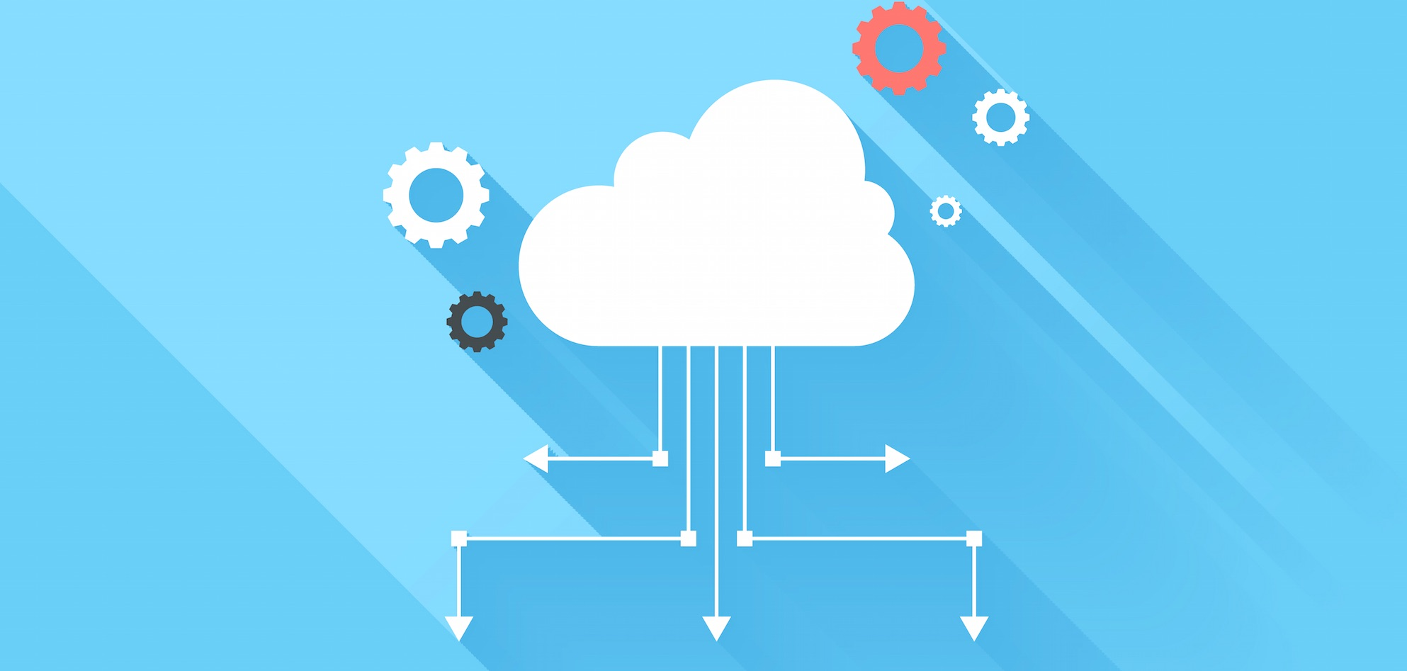
New Technology?!

Slide 3
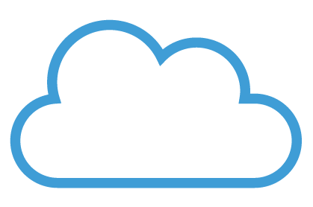
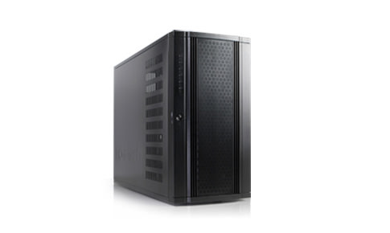

Slide 5

Extra Load
Success!

Slide 7

To reach out a website you should write something like that
www1.sth.com
www2.sth.com
.
.
.
wwwn.sth.com
What about if you got a bigger server that handles more requests and want to git rid of one of these servers?

Slide 8
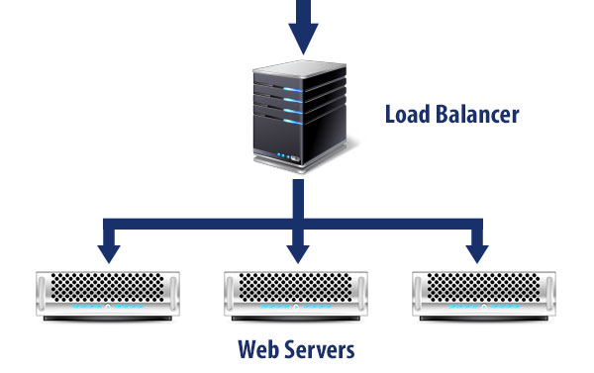

Slide 9

Load
balancer
Route
Balance

Slide 10
Load
balancer
How to know that one server is out of service?
Heartbeat
But, What if the “Load Balancer” goes down?
Single Point Of Failer (SPOF)

Slide 12
Scaling
Vertical scaling
resize your server with no change to your code. It is the ability to increase the capacity of existing hardware or software by adding resources. Vertical scaling is limited by the fact that you can only get as big as the size of the server.
Notes:
imagine, if you will, an apartment building that has many rooms and floors where people move in and out all the time. In this apartment building, 200 spaces are available but not all are taken at one time. So, in a sense, the apartment scales vertically as more people come and there are rooms to accommodate them. As long as the 200-space capacity is not exceeded, life is good.
This could even apply to a restaurant. You have seen the signs that tell you how many people could be held in the establishment. As more patrons come in more tables may be set up and more chairs added (scaling vertically). However when capacity is reached no more patrons would be able to fit. You can only be as big as the building and patio of the restaurant. This is much like in your cloud environment, where you could add more hardware to the existing machine (RAM and hard drive space) but you are limited to capacity of your actual machine.

Slide 13
Scaling
Horizontal scaling
connect multiple hardware or software entities, such as servers, so that they work as a single logical unit. This kind of scale cannot be implemented at a moment’s notice.

Slide 14
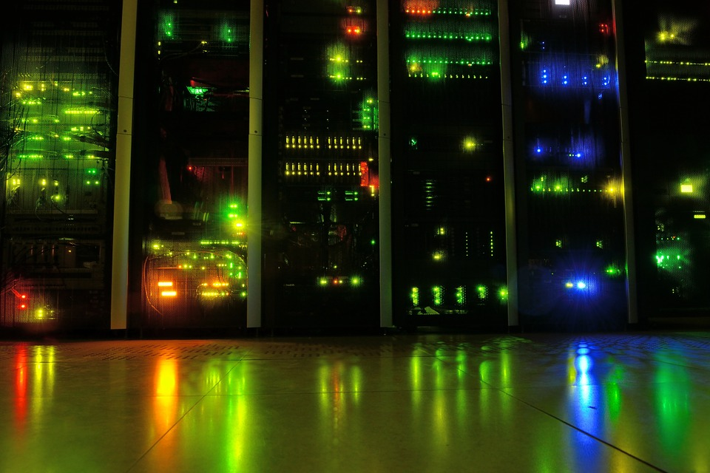
Physical Place
Equipment
Implementation
Heat
Electricity
Access
Security
Scaling
So why don’t we move all of these implementation away and rent a server in the cloud?

Slide 15
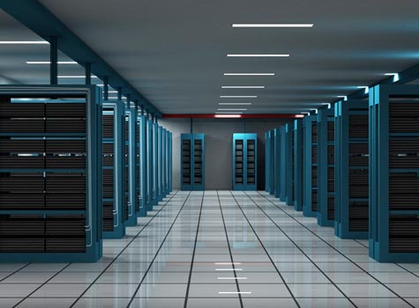
we could implement the architecture of our system and build the infrastructure virtually using software.
Infrastructure As A Service (IAAS)
We even could autoscale the architecture due to the situation & the number of clients.
Pay as much as you use.

Slide 16

Make it easier for you to run your application on the cloud
Platform As A Service (PAAS)
If I’m a software developer, then I really don’t care about the infrastructure. So, pay a little bit more to abstract away those kind of details.

Slide 17

For example your E-mail, you don’t really know the details about where emails are stored or how they tranfer….
Software As A Service (SAAS)
The all of underlying implementation delails are abtracted away.

